Slide 1
Building a Data Catalog for AI
Mandy Chessell, IBM

Slide 2
Agenda
Background to the lab (presentation)
Lab
Further topics

Slide 3

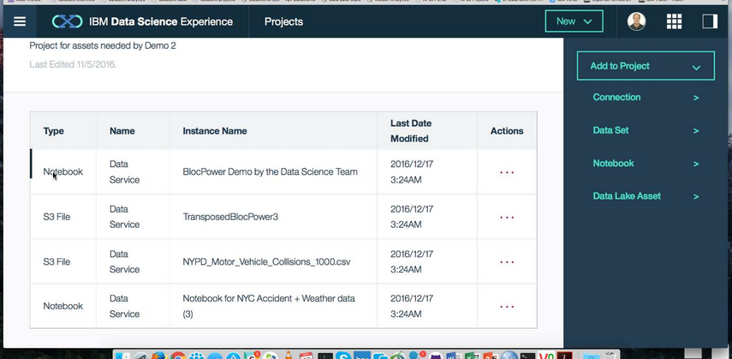
The perils of reusing data …
Callie Quartile
Data Scientist
Callie Quartile uses (1) open data from the local government registrar and (2) data from the employee directory to (3) create a birthday card service for the company.
Open Data
Site
Data Lake
1
3
2
Employee Directory

Slide 4

The perils of reusing data …
But its not my birthday
Callie Quartile
Data Scientist
Happy
Birthday
Unfortunately the obvious date in the registrar record was the registration of birth date not the date of birth. Date of birth was not published in the open data.
Callie needed better information about the open data to realise she had the wrong data.
Open Data
Site
Data Lake
1
3
2
Employee Directory

Slide 5

Curation
I wonder what this means
00 3809890 6 7 Lemmie Stage 818928 3082 4 New York 4 27 DataStage Expert 1 45324 300 27 Code St Harlem NY 1 3
00 3809890 3 7 Callie Quartile 328080 7432 5 New York 4 27 Data Scientist 1 56944 045 27 Code St Harlem NY 1 3
00 3809890 1 7 Tanya Tidie 209482 4051 2 New York 4 27 Data Steward 1 43800 215 27 Code St Harlem NY 1 3
I know

Slide 6
Scared to share
Very Sensitive Data
Very Sensitive Data
Faith Broker
Human Resources
00 3809890 6 7 Lemmie Stage 818928 3082 4 New York 4 27 DataStage Expert 1 45324 300 27 Code St Harlem NY 1 3
00 3809890 3 7 Callie Quartile 328080 7432 5 New York 4 27 Data Scientist 1 56944 045 27 Code St Harlem NY 1 3
00 3809890 1 7 Tanya Tidie 209482 4051 2 New York 4 27 Data Steward 1 43800 215 27 Code St Harlem NY 1 3
00 3809890 6 7 Lemmie Stage 818928 3082 4 New York 4 27 DataStage Expert 1 ##### ### 27 Code St Harlem NY 1 3
00 3809890 3 7 Callie Quartile 328080 7432 5 New York 4 27 Data Scientist 1 ##### ### 27 Code St Harlem NY 1 3
00 3809890 1 7 Tanya Tidie 209482 4051 2 New York 4 27 Data Steward 1 ##### ### 27 Code St Harlem NY 1 3
Callie Quartile
Data Scientist

Slide 7
A catalog should bring as much information about the data sets to Callie’s data science as is known collectively by the organization.
X
Column: Band
X
Data Set Name: Employee Directory
X
Characteristics
Lineage
Description
Position reference number for non-exempt employees. The value ranges from 01 to 06 where 01 is the most senior and 06 is the most junior.
Description:
Core attributes describing all employees of Coco Pharmaceuticals created from a daily extract from Kenexa.
Owner: Penny Payer
Classification Ranges:
Confidentiality: Public, Confidential, Sensitive
Confidence: Authoritative
Retention: Indefinitely
Type: String
Classification: Public
Status:
Last accessed: 6th May 2016
Records: 3488
Last Update: 1st May 2016
Employee Directory
Name
Band
Job Title
Contents:
Structure …
Contents …
Lineage …

Slide 8
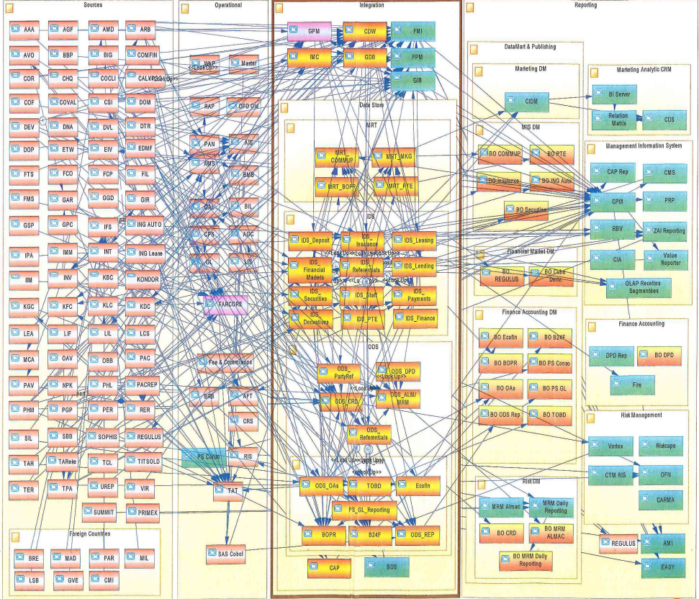
Real Data Landscapes
Complexity is biggest challenge in IT today
Many enterprises have had 40 years of innovation embedded into their IT Systems.
With data moving rapidly between systems, how can a data scientist be sure that they understand the meaning, accuracy, timeliness and precision of any data that they receive?

Slide 9
What is a fact?
Where do you live?

Slide 10
What is a fact?
Context
Where do you live?

Slide 11

Data needs to work harder …
Regulations and a need to operate a coherent, connected business made it necessary to extract data from original application, combine it and use it in new contexts.
Data is now like a tortoise without its protected shell.
The infrastructure and people that support this data need to recreate the protected shell for their data.

Slide 12
What is at stake?
Value when you use it effectively
New business opportunities
Cross-sell/up-sell
Operational efficiencies and agility (including compliance)
Used across multiple business processes
Cost/Risk if you abuse data
Data breaches, not following privacy policies
Regulatory compliance issue, loss of reputation, etc.
Cost/Risk if you lose it (availability/backup)
Business outage
Compliance issues
Cost/Risk if you confuse it (data quality)
Bad business decisions
Customer satisfaction problems
More regulatory compliance issues
Breaking of contractual obligations
Notes:
Many organizations do not think about the value of their data – which is why many do not have a data governance program. This is surprising - when answering these questions, it quickly becomes apparent that their data is a key asset – and yet it is not given the care and maintenance of more physical assets.
Four key questions to ask to assess the value of your data.
Value when you use it effectively
New business opportunities
Cross-sell/up-sell
Operational efficiencies and agility (including compliance)
Used across multiple business processes
Cost/Risk if you abuse data
Data breaches, not following privacy policies
Regulatory compliance issue, loss of reputation, etc.
Cost/Risk if you lose it (availability/backup)
Business outage
Cost/Risk if you confuse it (data quality)
Bad business decisions
Customer satisfaction problems
More regulatory compliance issues
Breaking of contractual obligations
The goal of a data governance program is to increase data value, decrease data risks/costs

Slide 13
Using a metadata repository to describe data
Metadata
Repository

Slide 14

The world is changing too rapidly for a single vendor tool suite to cover an organization’s data management needs
New technology innovation
No cross-vendor buy-in

Slide 15
Today’s reality – organizations buy lots of tools

Slide 16
ODPi Egeria enables exchange of metadata between tools from different vendors
Development
DevOps
Data Science
Open and
Unified Metadata

Slide 17
Coco Pharmaceuticals persona
https://odpi.github.io/data-governance/coco-pharmaceuticals/personas/

Slide 18
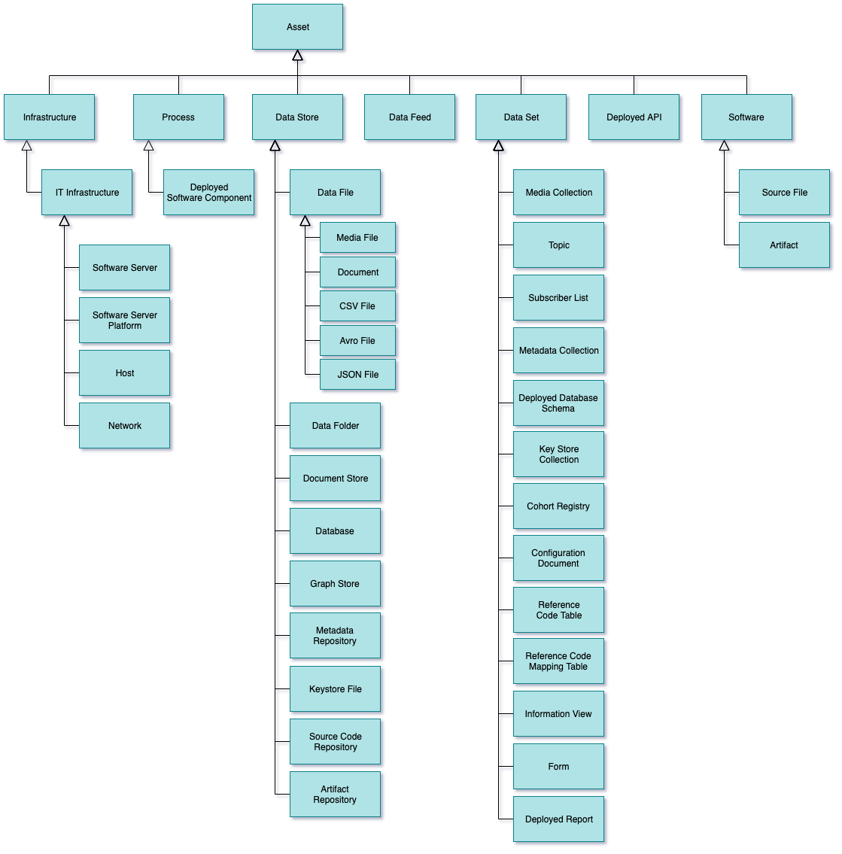
Types of Asset
Infrastructure – hardware and software generic “platforms”.
Process – well defined sequence of actions.
DataStore – data at rest
DataFeed - data in motion
DataSet – collection of data
DeployedAPI – interface
Software – parts for IT system

Slide 19
Your Lab Today
Start up the server platforms
Configure the servers
Run Lab “Building a Data Catalog”

Slide 20
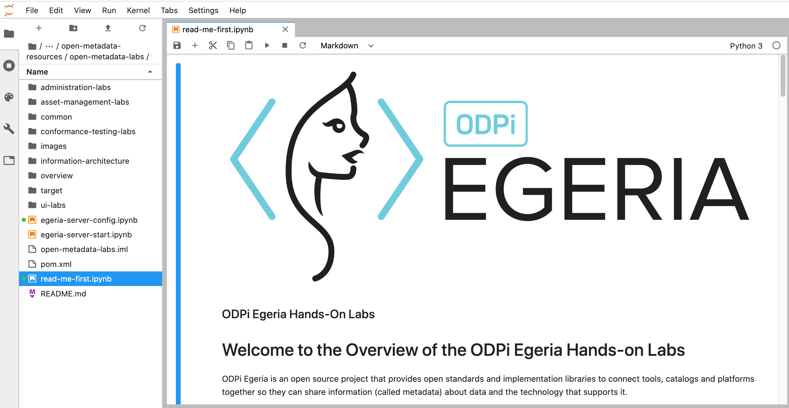
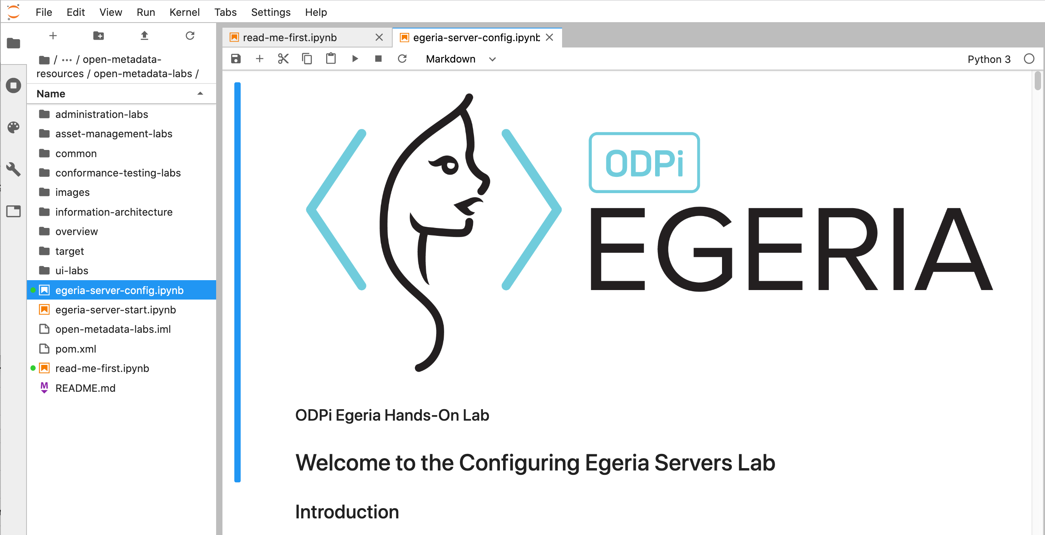
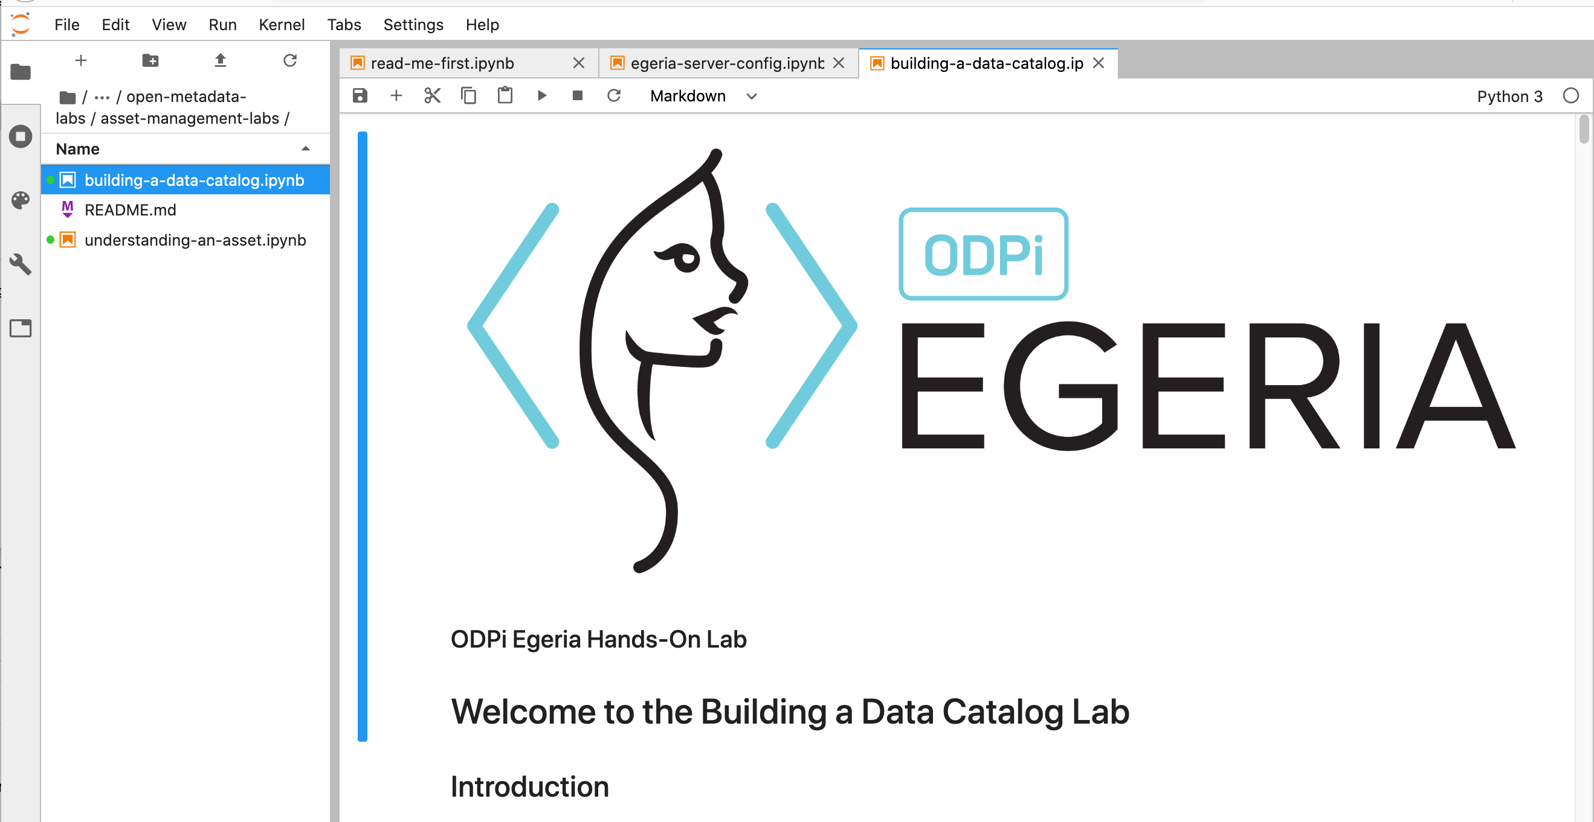
Lab Flow

Slide 21
Egeria Summary
Open Metadata Ecosystem
Open Source
Open Standards
Heterogeneous interoperability between third party tools
Comprehensive coverage of digital activities
Focus on automation
Digital
Services
Development
Data Lake
Operations
Chief Data Office
Analytics
DevOps

Slide 22





The data driven organization …
Collaborating across all 3 lifecycles
Governance Teams
Policy
Policy
Audit
Define
Asset Owners
Enterprise Architecture
Monitor
Policy
Roll out
Classify
Operations
Policy
Metadata
Development
Stewards
Design
Execute
Business Users
Deploy
Developers
Detect
Remediate
Develop
Data Scientists
DevOps

Slide 23
Scope of metadata covered
Governance
Glossary
Collaboration
Models and
Reference Data
Lineage
Metadata
Discovery
Data Assets
Base Types, Systems
and Infrastructure

Slide 24
Scope of metadata covered
Strategy
4
Subject Area Definition
1
Teaming Metadata
(people profiles, communities, projects,
notebooks, …)
Policy Metadata (Principles, Regulations, Standards, Approaches, Rule Specifications, Roles and Metrics)
Business Objects and Relationships, Taxonomies and Ontologies
Augmentation
3
Organization
Feedback Metadata
(tags, comments, ratings, …)
Rollout
Classification
Business Attributes
Campaigns and Projects
Classification Schemes
Implementation
Mapping
Governance Actions and Processes
Rights
Management
Models and Schemas
2
Asset Collections
(Sets, Typed Sets, Type Organized Sets)
Reference Data
5
Instrument
7
Information Process
Instrumentation (design lineage)
Association
Information Views
Augmentation
Discovery
Metadata (profile data, technical classification, data classification,
data quality assessment, …)
Physical Asset Descriptions
(Data stores, APIs,
models and components)
0
Basic Types, Infrastructure and Systems
Access
6
Connectors

Slide 25
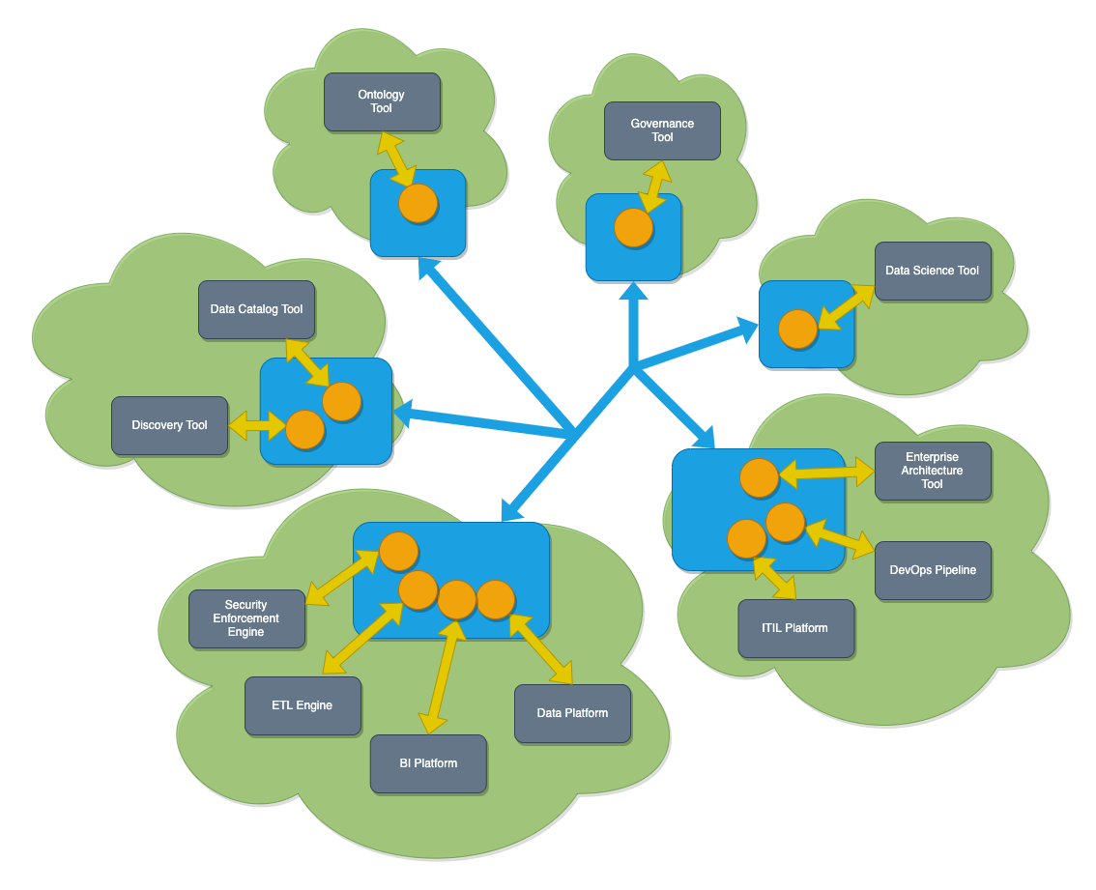
Egeria in operation
Egeria’s platform (in blue) runs in each deployment environment (cloud or on premises)
Egeria servers (orange circles) are deployed on the platform. Each are specialized to support the metadata needs of specific technologies
Egeria manages the exchange of metadata between all parties.

Slide 26
Open forum
z
z
z
z
z
z
z
Questions?

Slide 27
Links
Press Release and Podcast
Open source repositories
https://www.linuxfoundation.org/press-release/2018/08/odpi-announces-egeria-for-open-sharing-exchange-and-governance-of-metadata/
https://roaringelephant.org/2018/09/25/episode-107-open-metadata-and-governance-masterclass-with-mandy-chessell-part-1/
https://roaringelephant.org/2018/10/09/episode-109-open-metadata-and-governance-
masterclass-with-mandy-chessell-part-2/
https://github.com/odpi/data-governance
https://github.com/odpi/egeria

Slide 28
